Slide 1
Overview
Factors affecting transaction duration
Our model
Example prediction
Distribution of sales quantity
Itemized comparisons
Conclusion
Suggestions for improving concession throughput
Improve efficiency to increase sales quantity
Notes:
Explain the data we have
Data from March 2019 concession sales
Racing Concessions, DD Deli, Derby Bar
Video data that we collected from Derby Bar, March 3rd, 1:30-2:30pm
Talk about the structure of this project

Slide 2
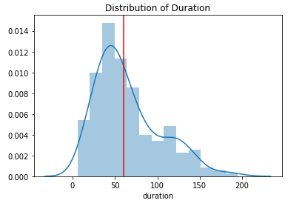
1. Factors Affecting Transaction Duration
Notes:
Here is the distribution of transaction durations, using the video data from derby bar on March 3rd
Red line is at the one minute mark; ideally, average transaction time would be under that

Slide 3
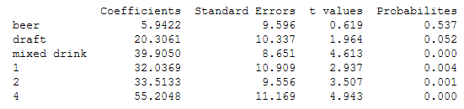
Model
Optimized the parameters of our model
Those factors are:
Beer, Draft, Mixed Drink, Station 1, Station 2, Station 4
Notes:
THESE are the optimized parameters
Talk about testing different models and which one we picked – linear btw Bill
Expand on the factors
Split up beer bottles and cans, drafts
Expand on what those coefficients are
Explain why beer was insignificant
Significance level, alpha = .10

Slide 4
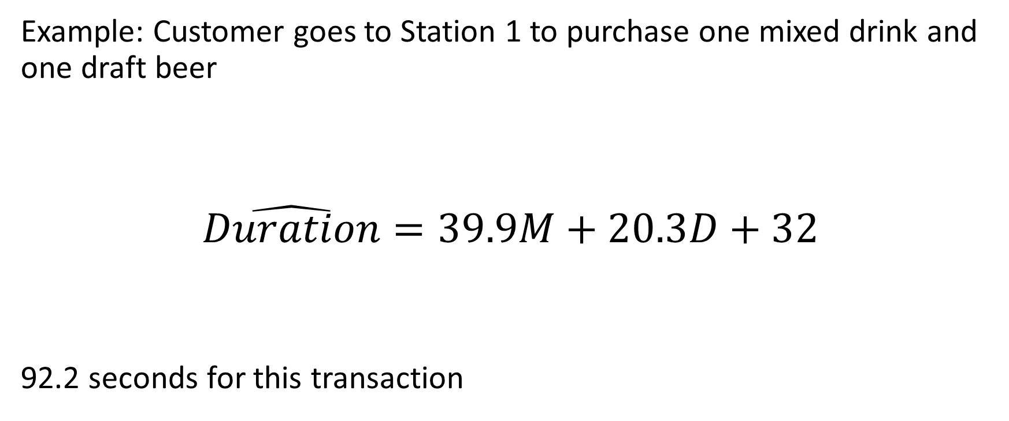
Example Transaction using Predictive Model
Example: Customer goes to Station 1 to purchase one mixed drink and one draft beer
$$\hat{Duration}=39.9M+20.3D+32$$
92.2 seconds for this transaction
Notes:
Duration is computed by adding the coefficients for average duration per mixed drink and draft beer with the constant average time for that station
This transaction is estimated to last 92.2 seconds, which is over 30 seconds longer than our desired time of one minute.

Slide 5
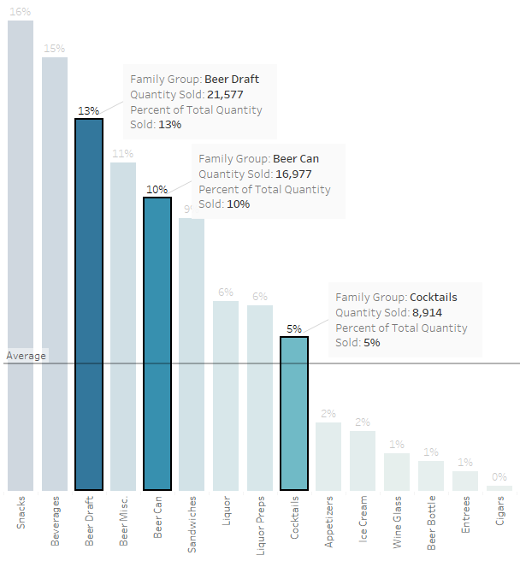
2. Distribution of Sales
Group Comparisons
Beer Drafts
Beer Cans & Bottles
Cocktails (Mixed Drinks)
Notes:
This is all racing concession sales, month of March 2019
Highlight the three categories we will be looking at
We shall DRILL DOWN

Slide 6
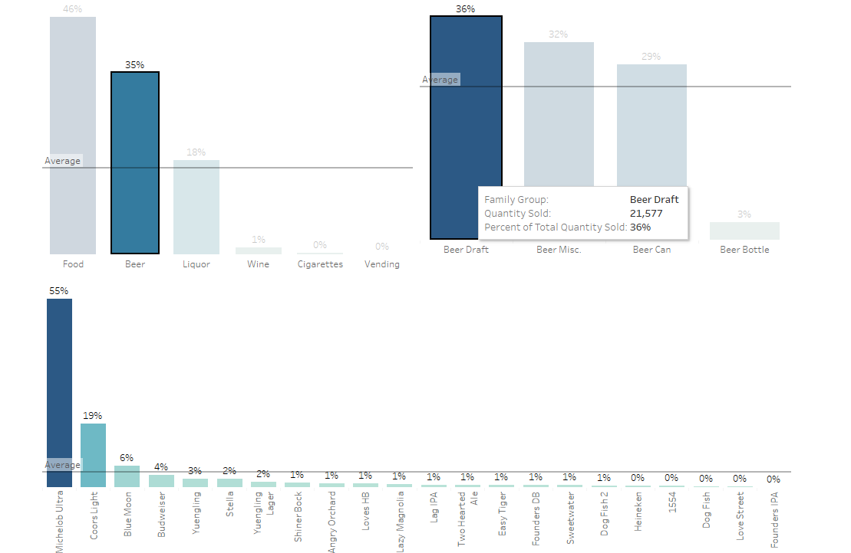
Notes:
Beer Draft
Walk through the percentages for each group, and then look at the uneven sales at an itemized level
Highlight the main items

Slide 7
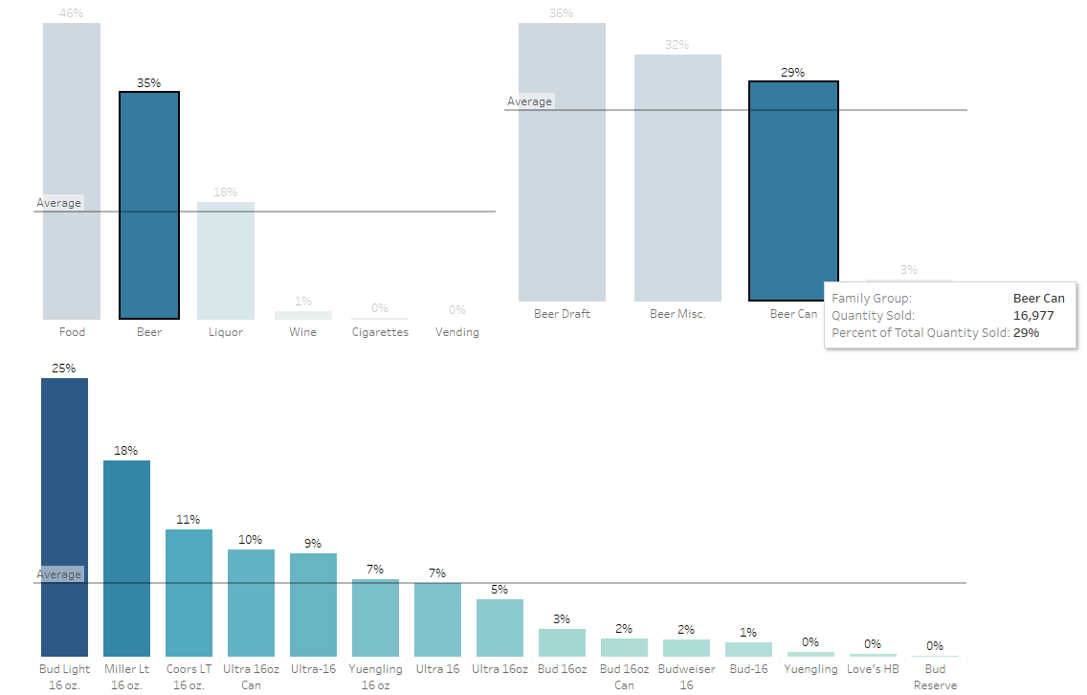
Notes:
Beer Cans & Bottles
Walk through the percentages for each group, and then look at the uneven sales at an itemized level
Highlight the main items

Slide 8
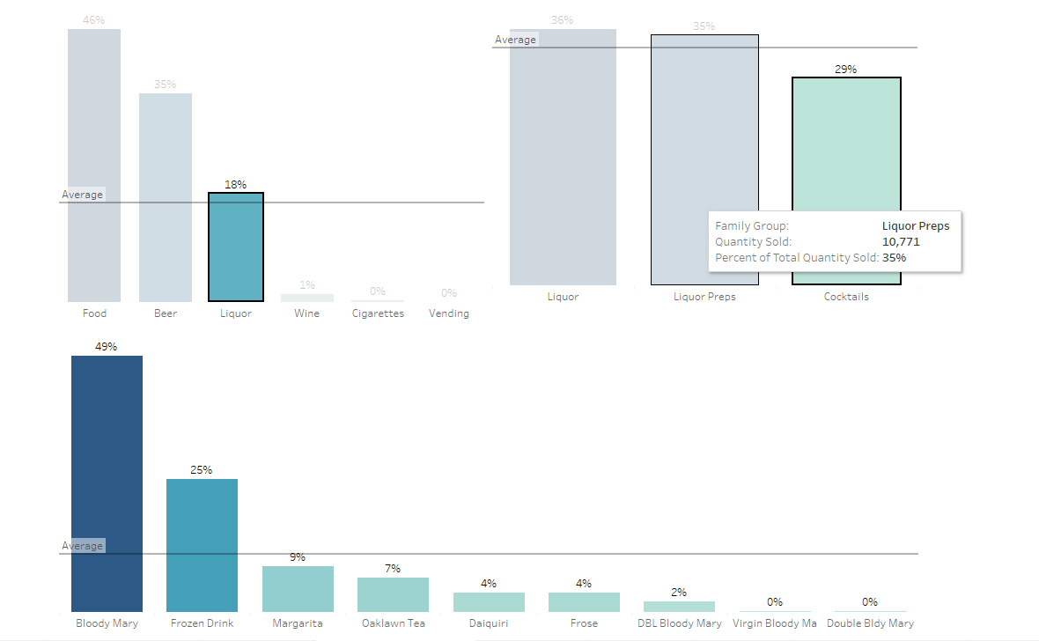
Notes:
Cocktails (Mixed Drinks)
Walk through the percentages for each group, and then look at the uneven sales at an itemized level
Highlight the main items

Slide 9
3. Conclusion
Train bartenders
Premade mixed drinks
Rebuild your concession stands
High variety of products negatively impacts sales quantity
Notes:
Limiting the amount of products that are offered would reduce wait times, improving throughput and increasing sales volume.

